Slide 1

Unmanned Aerial Vehicles powered by Vision Transformer for Precision Agriculture
Department of Computer Science
CS Master Degree
Computer Vision course
Presented by
Francesco Peragine
f.peragine@studenti.uniba.it

Slide 2
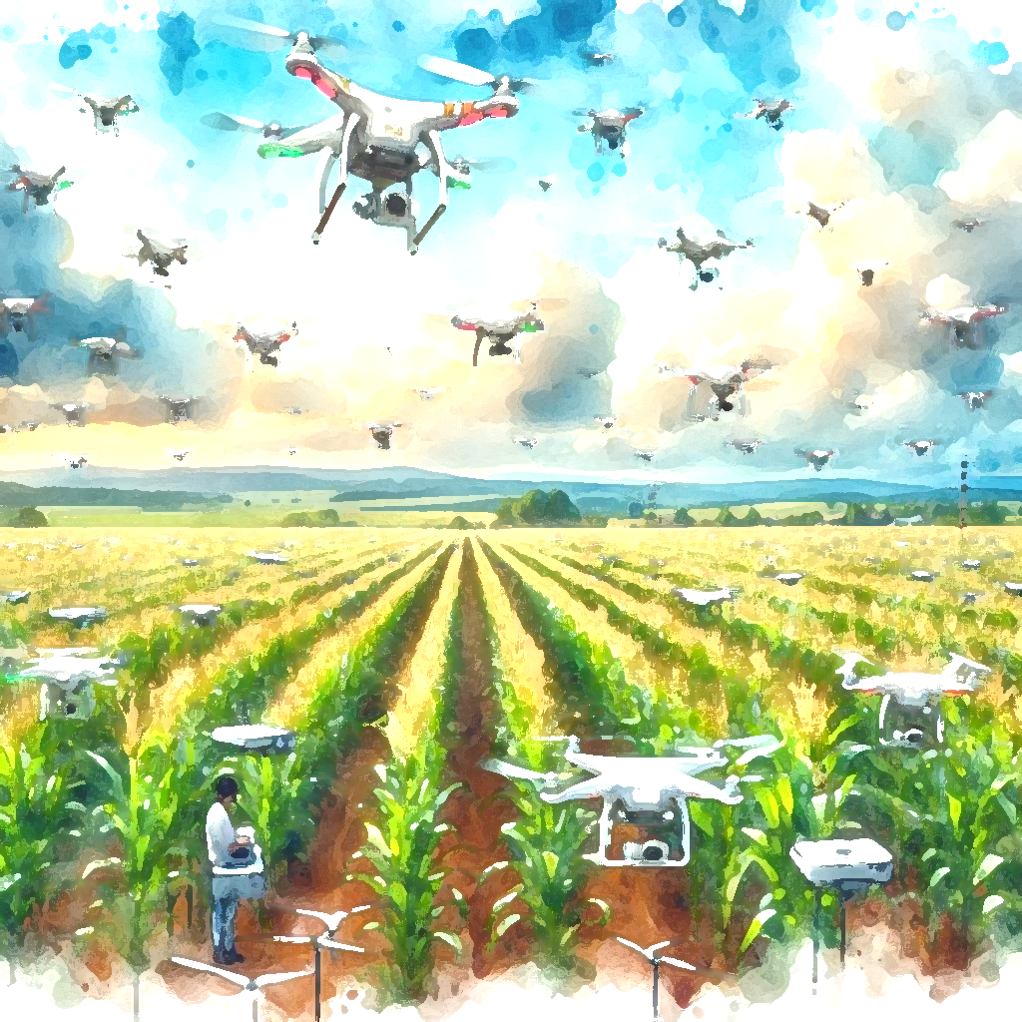
Introduction
Related Work
Data
Methods
Experiments
Results
Conclusion
Agenda

Slide 3
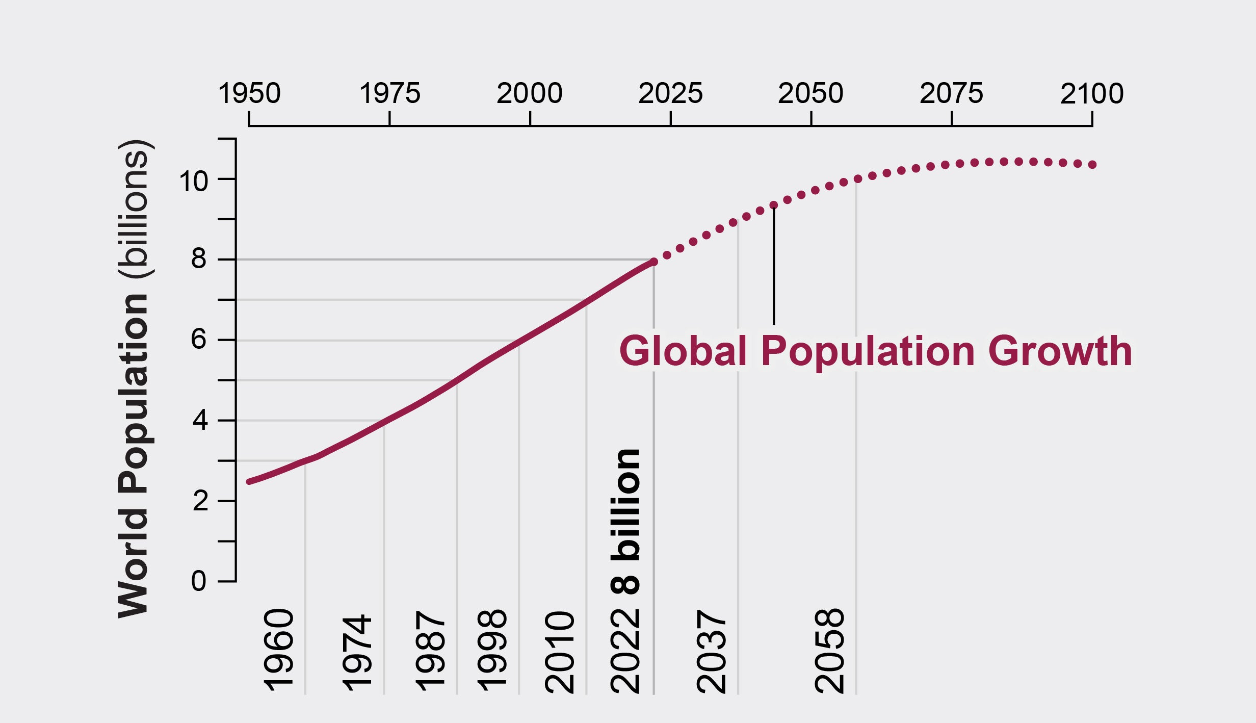

Introduction
Global challenge
Precision agriculture
Unmanned Aerial Vehicles powered by Vision Transformer for Precision Agriculture
3

Slide 4
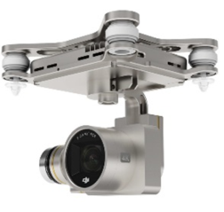
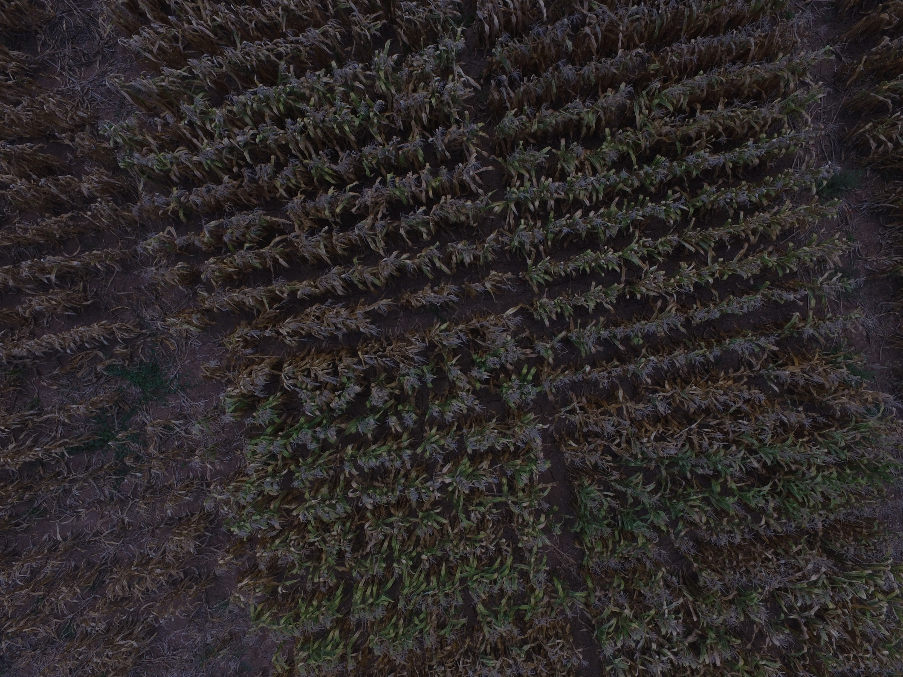
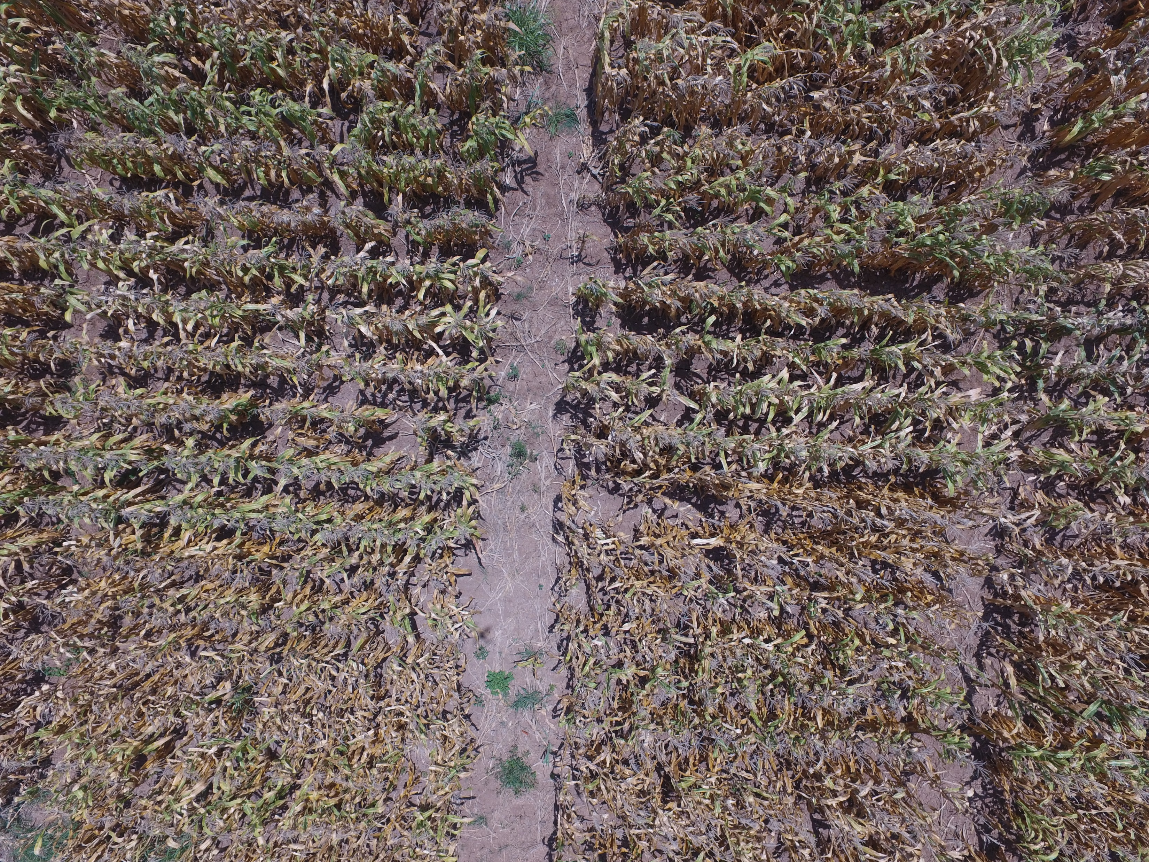
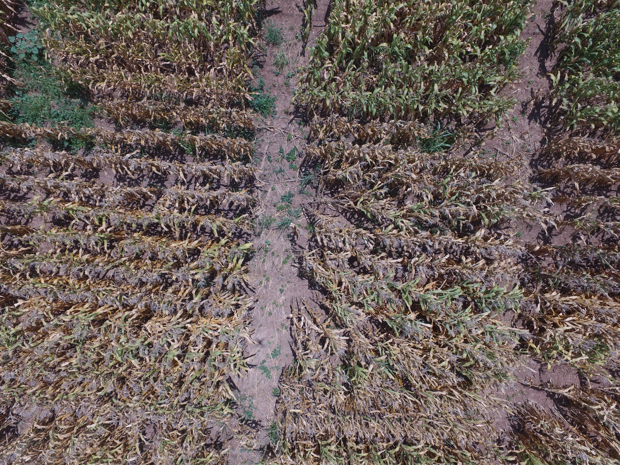
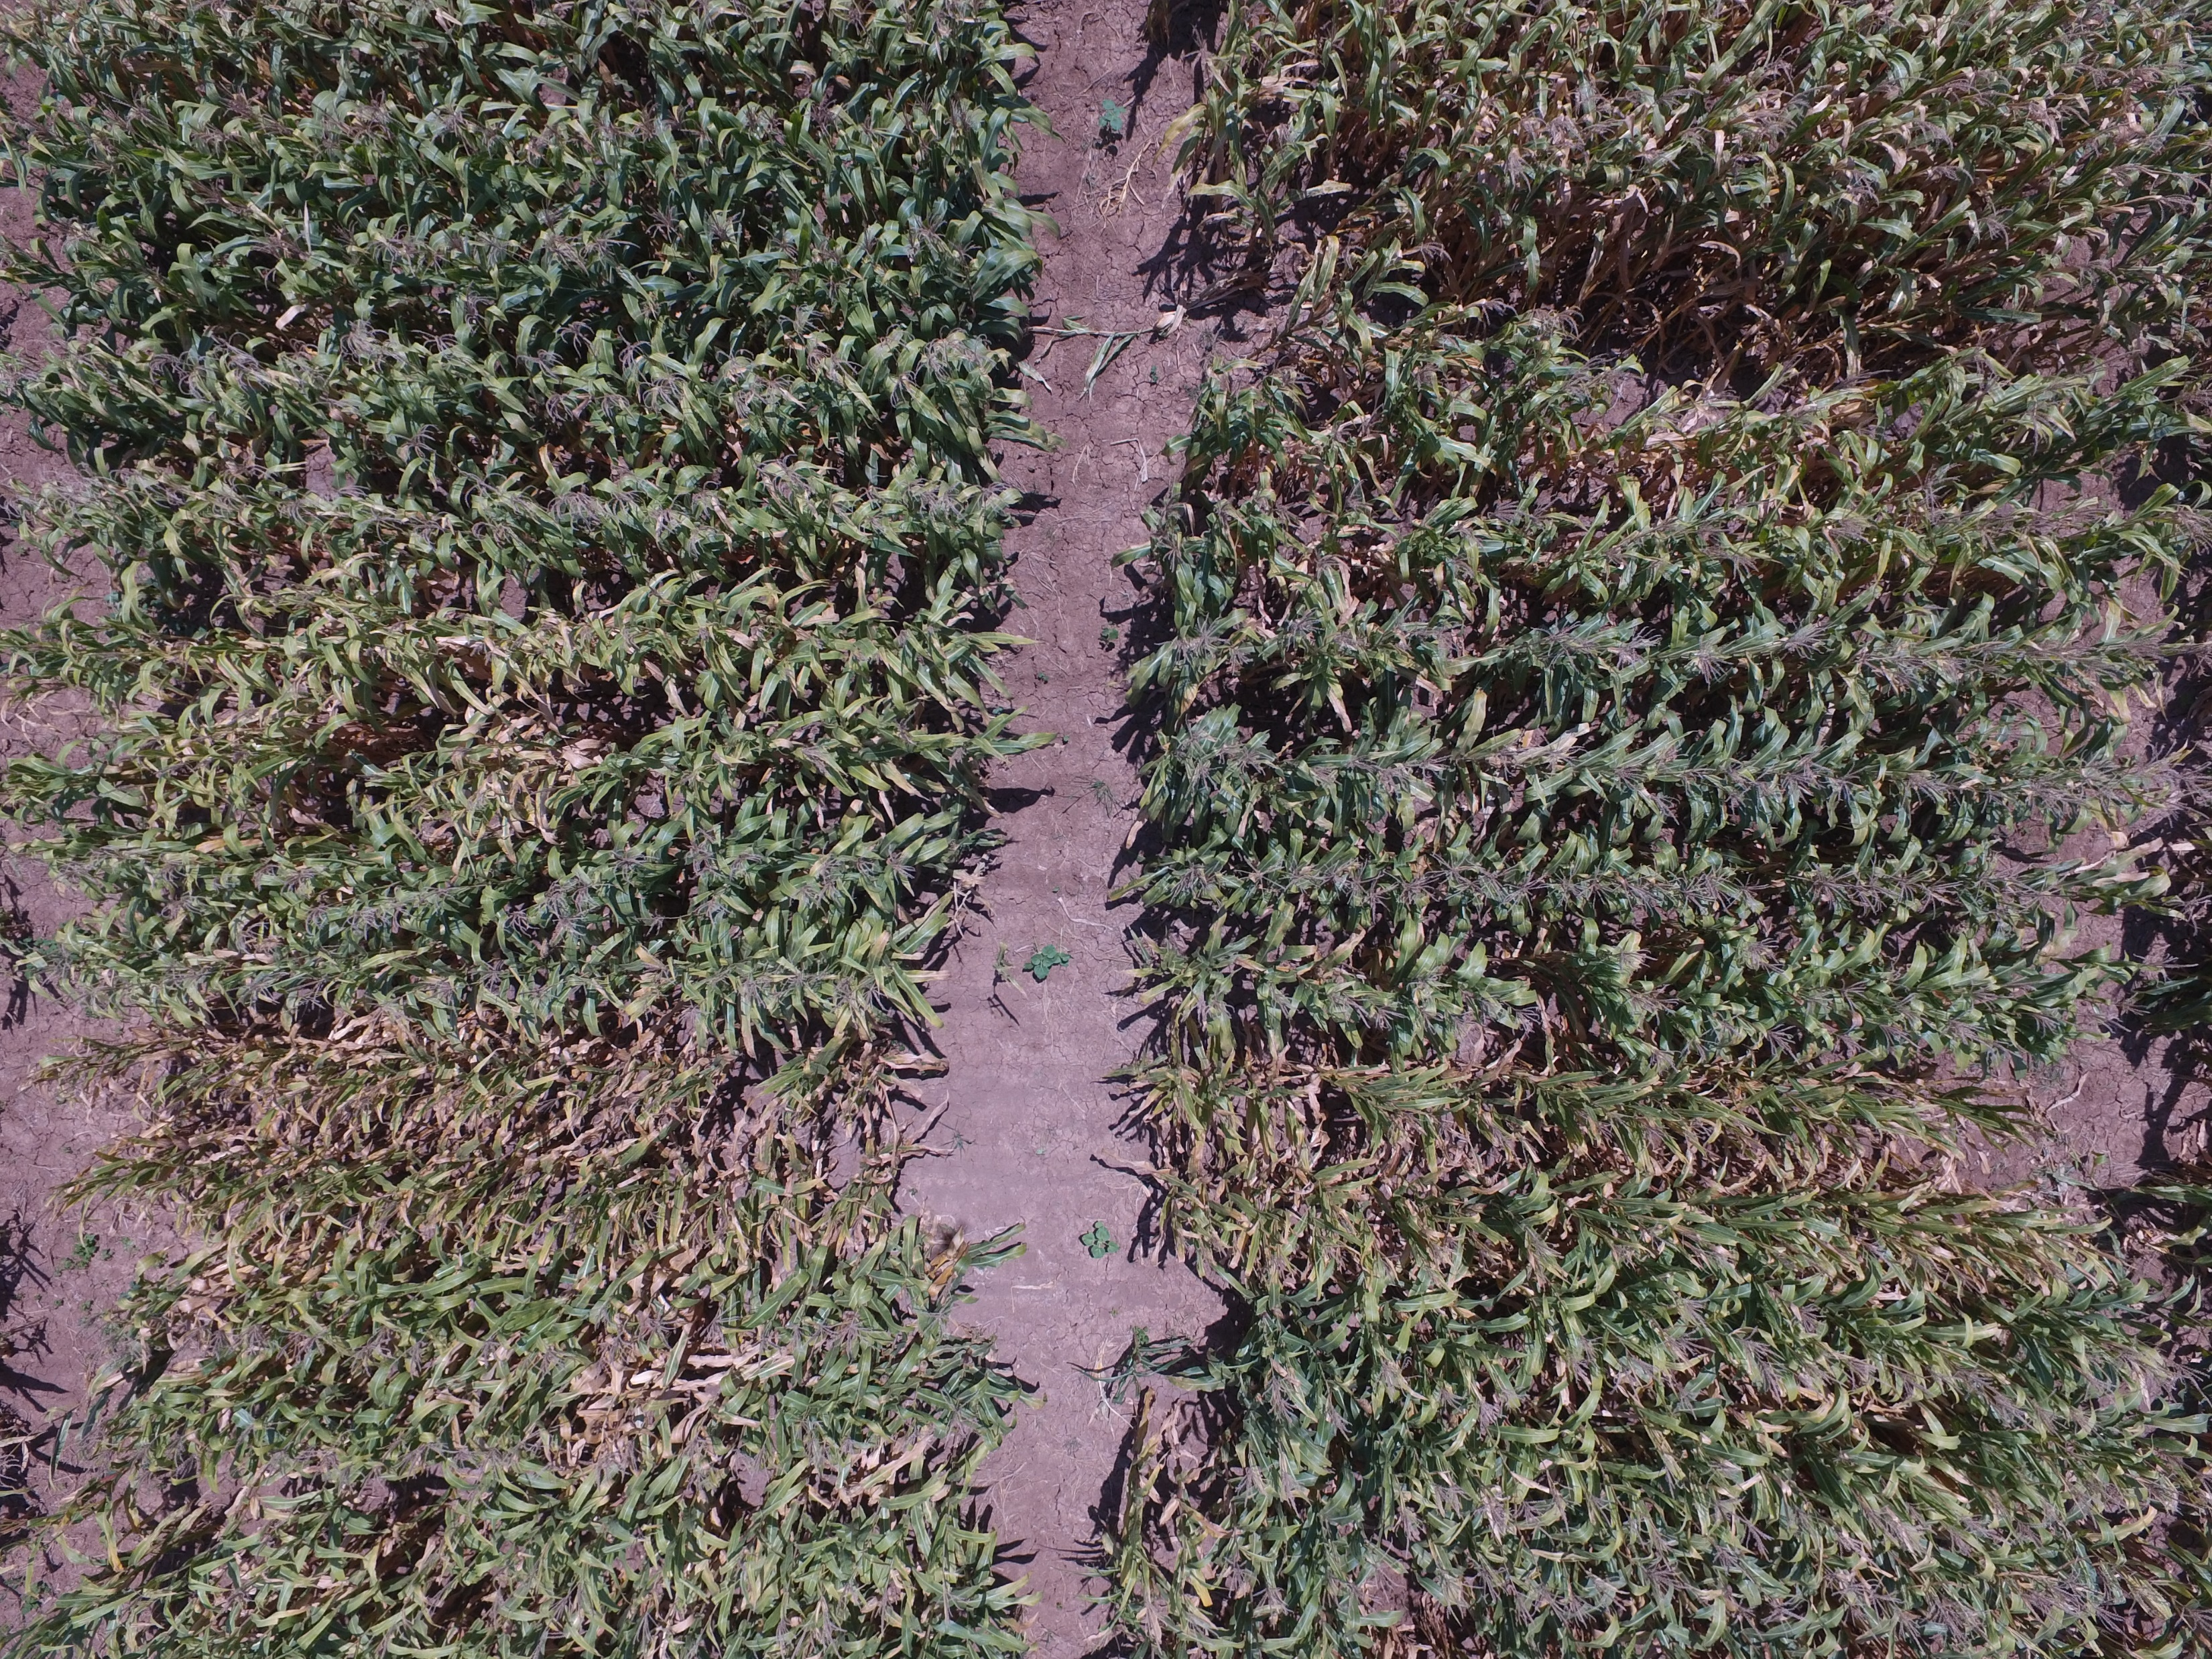
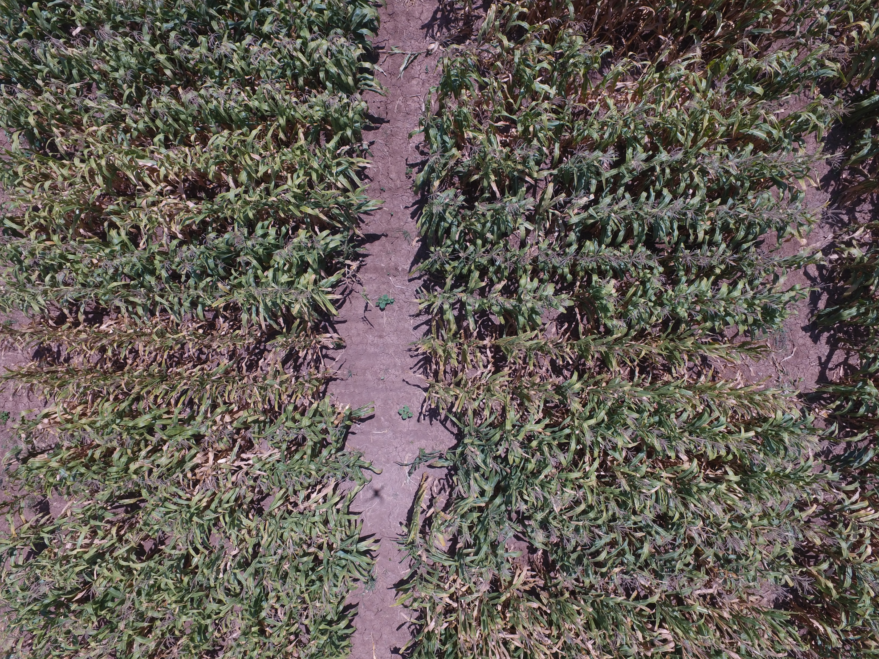
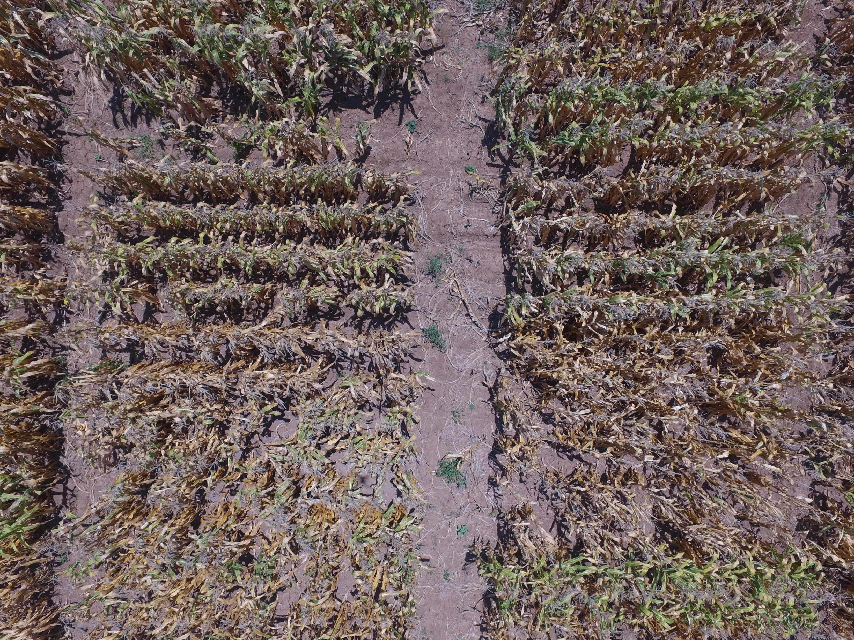
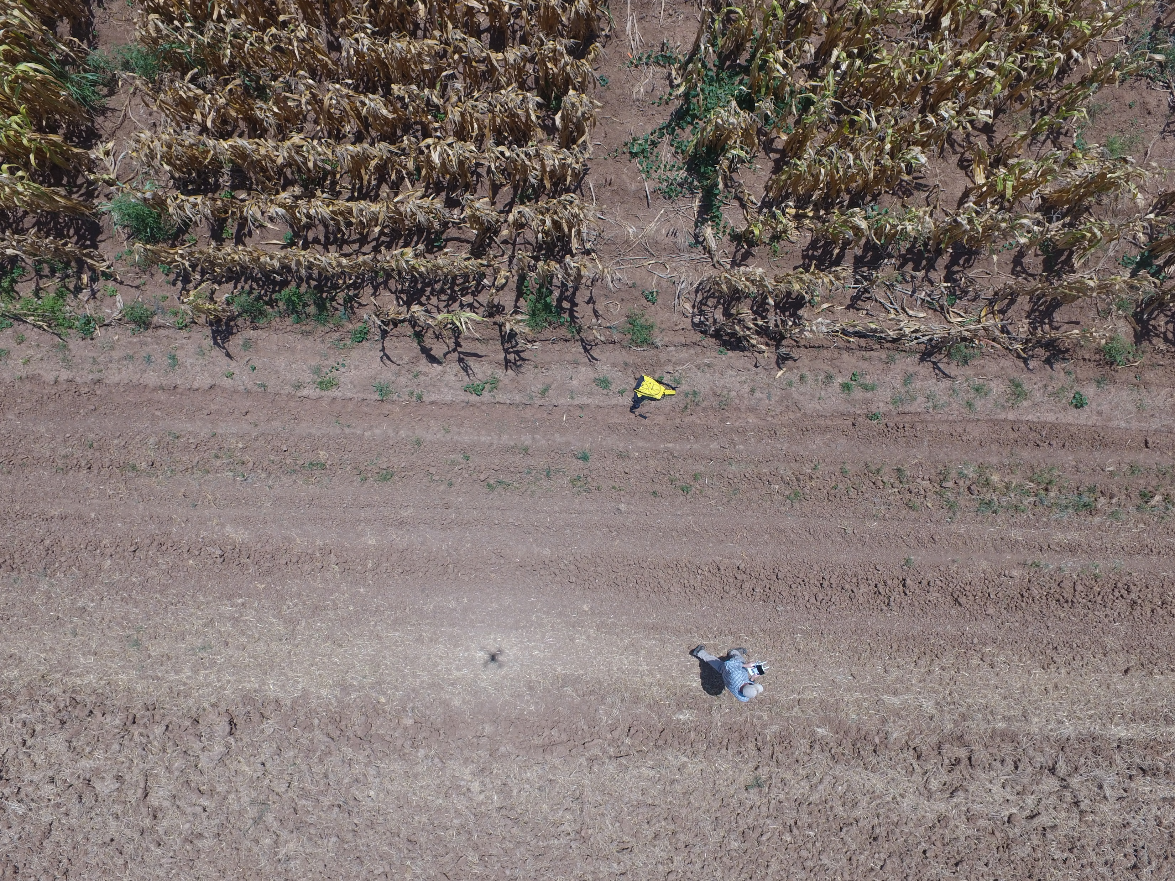
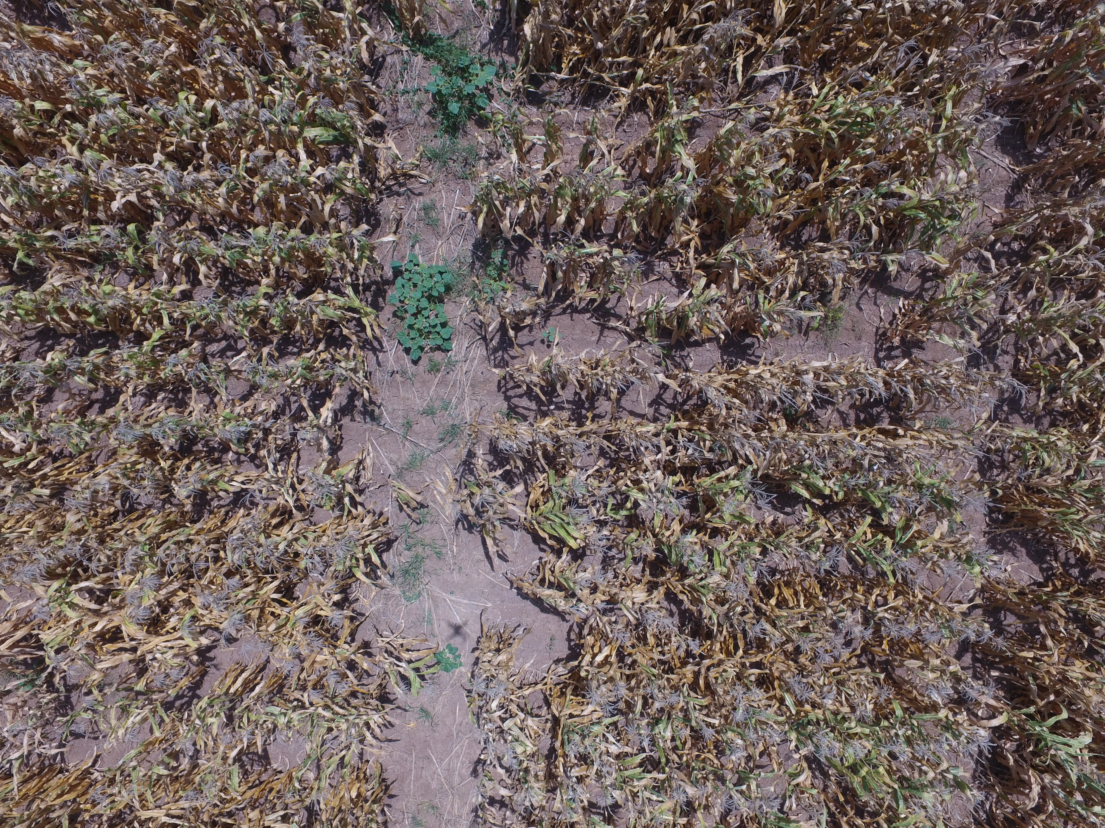
Related Work
Builds on Unmanned Aerial Vehicles for High-Throughput Phenotyping and Agronomic Research
Data
1,700 overlapping images
Shapefiles
Ground Control Points (GCPs)
Plots
Ground Truth

Slide 5

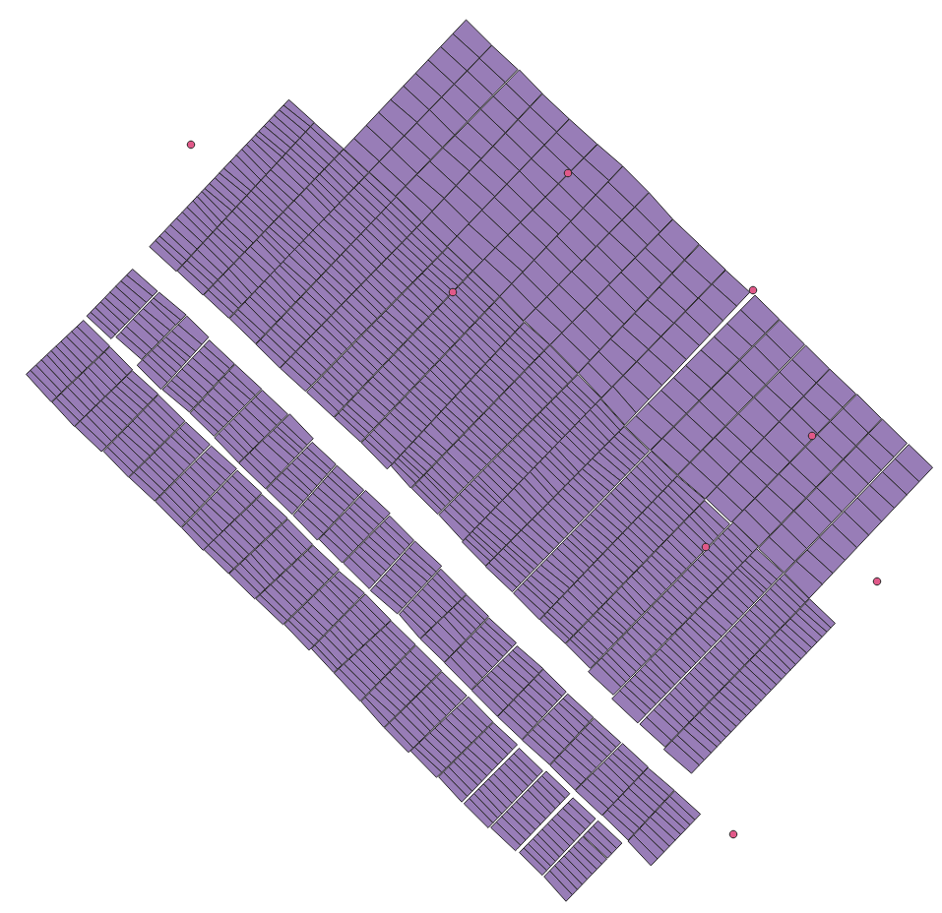
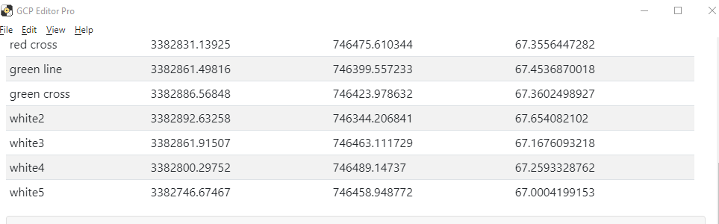

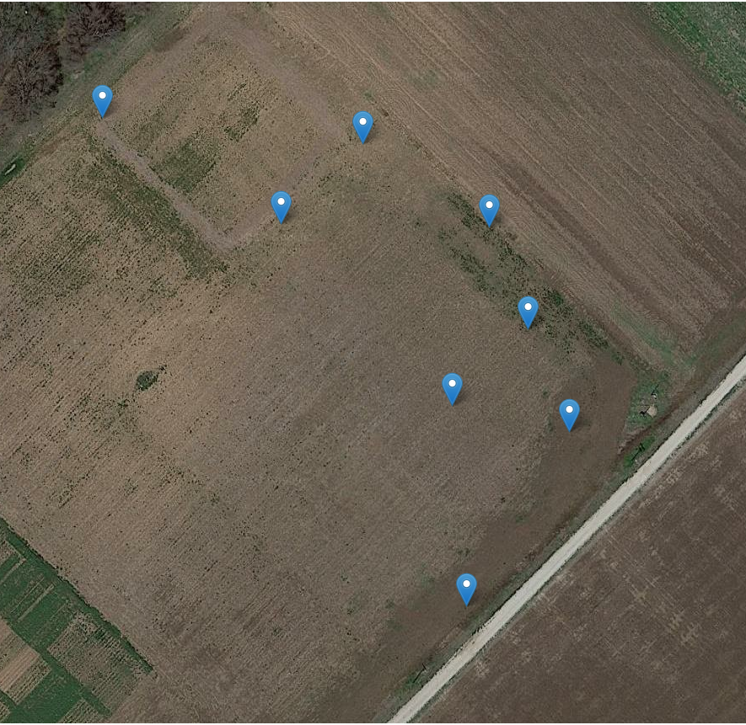
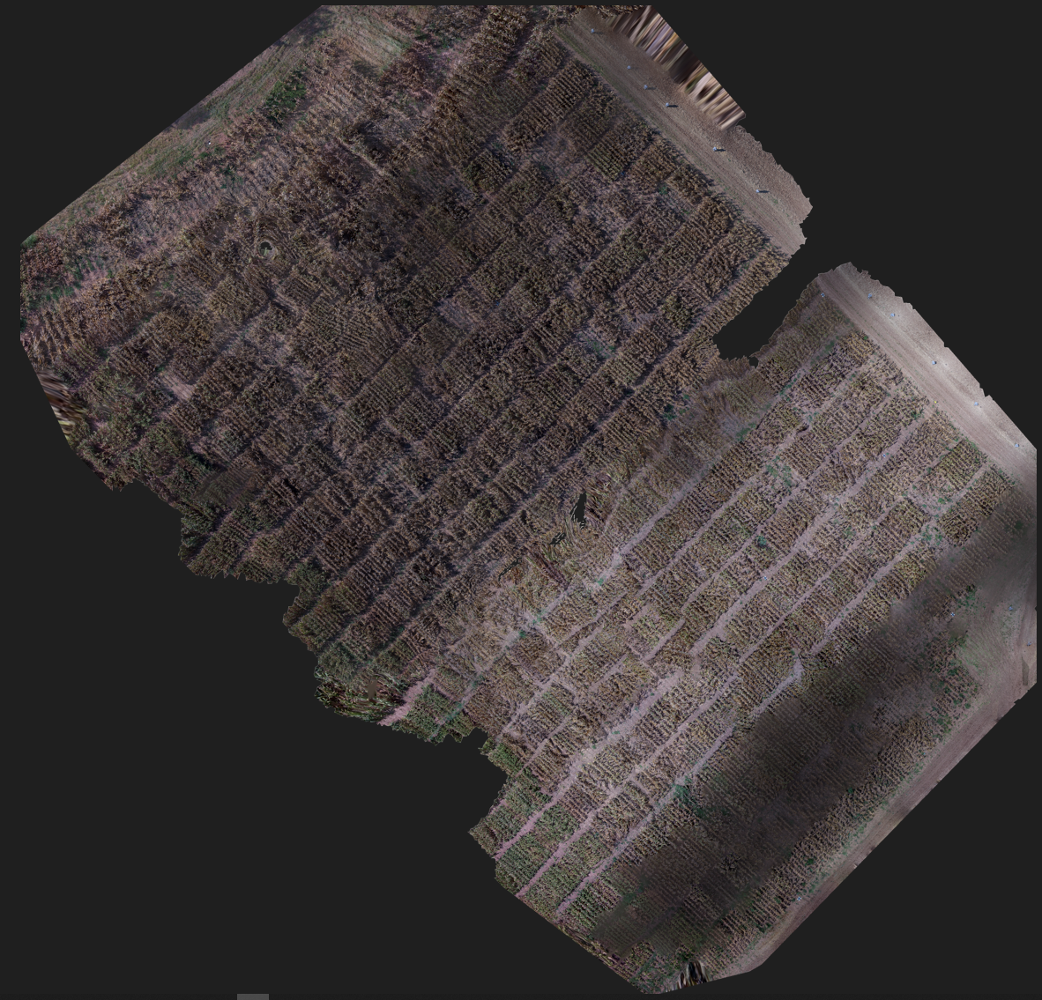


Preprocessing
QGIS – shapefile visualization, GCPs exports
GCPFinder (thanks to Dr. De Marinis) –
Move images to respective GCPs’ folders
GCPEditorPro – assign images to GCPs
WebODM – Orthomosaic generation
PySHP – extract GT from Orthomosaic

Slide 6
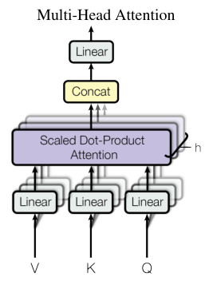

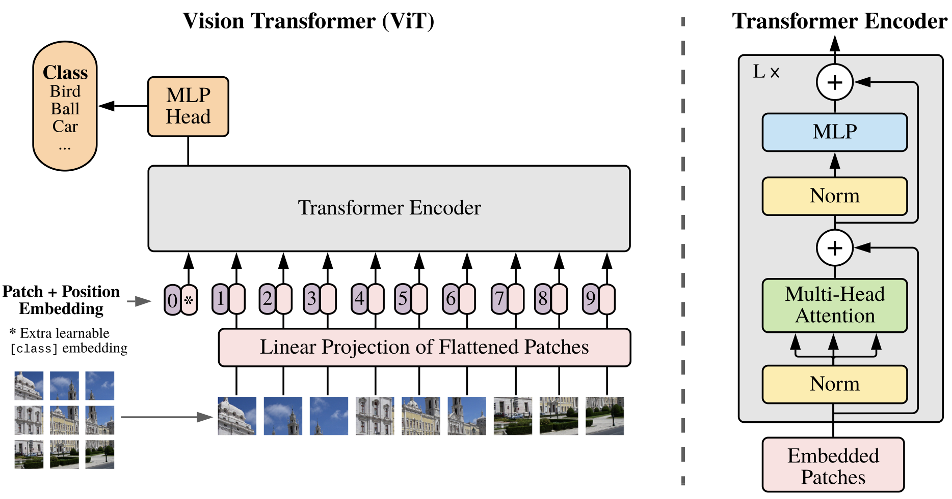

Methods
Vision Transformers
Transfer learning
Regression

Slide 7
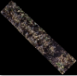
Experiments
Hyperparameters fine-tuning
Data augmentation
Custom transformation layers
Loss function
Optimizer
Linear Layer
SquarePad
Transformer Encoder
MinMax
Linear projection + position embedding
BaseDataset
Patch image generation

Slide 8
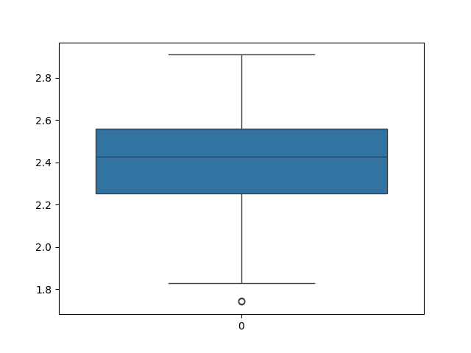
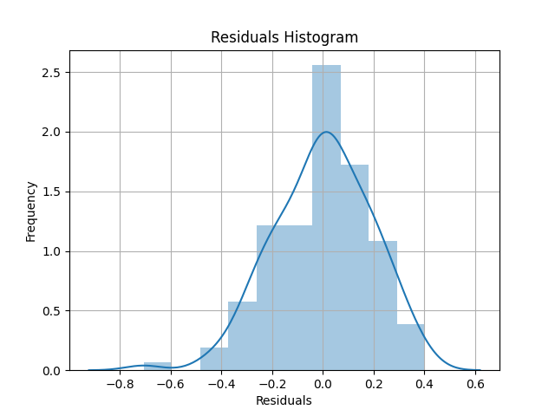
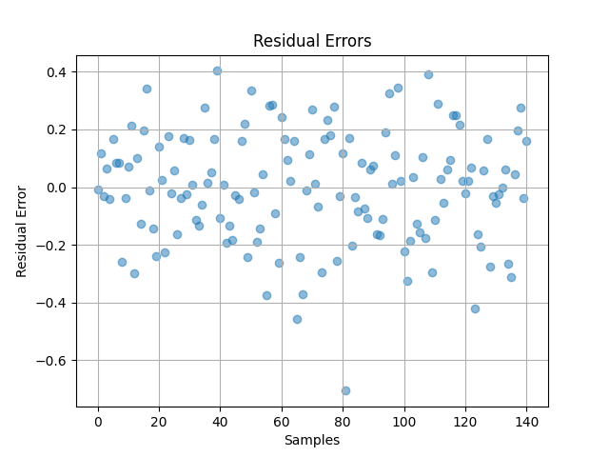
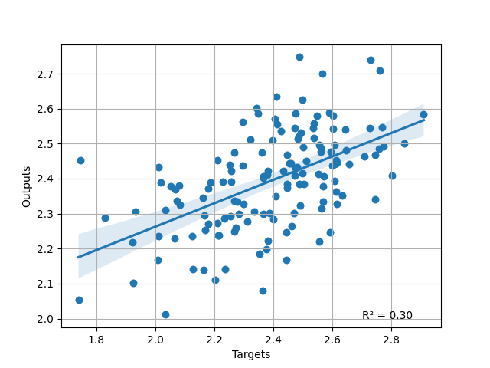
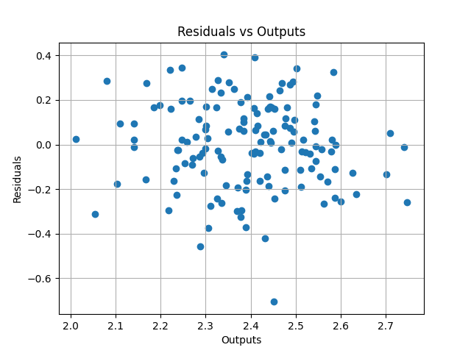
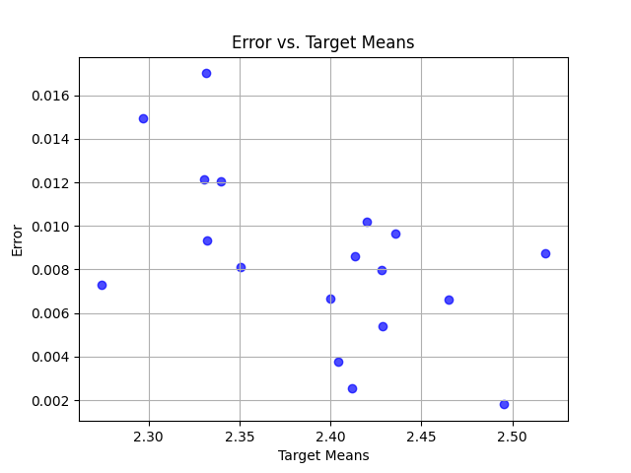
Results

Slide 9

Conclusion
Brand new challenges
Issues:
Ground truth
Small dataset
Preprocessing
Transfer learning
Different models
Different techniques (reinforced?)
Multispectral data

Slide 10
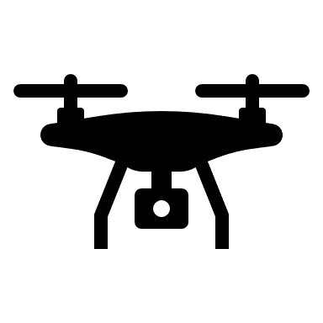
Thanks for your attention!
Unmanned Aerial Vehicles powered by Vision Transformer for Precision Agriculture

